Slide 1

Drone delivery system unit
Day 3
Standards:
8.PS2.3
8PS2.4
8.PS2.5

Slide 2
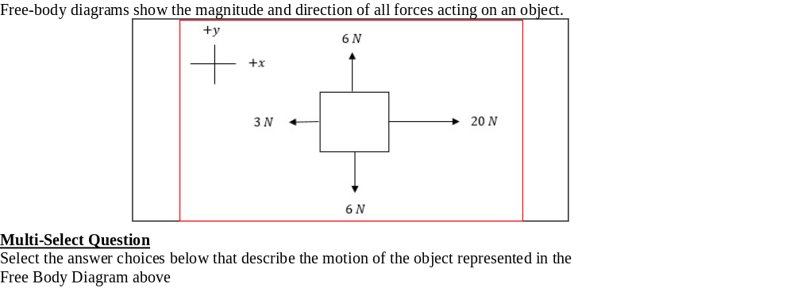

DQ
Choose 2 of the 3
a. The object will not have any acceleration up or down.
b. The object will have upward motion.
c. The object will accelerate to the right
Standards: 8.PS2.3, 8PS2.4, 8.PS2.5

Slide 3
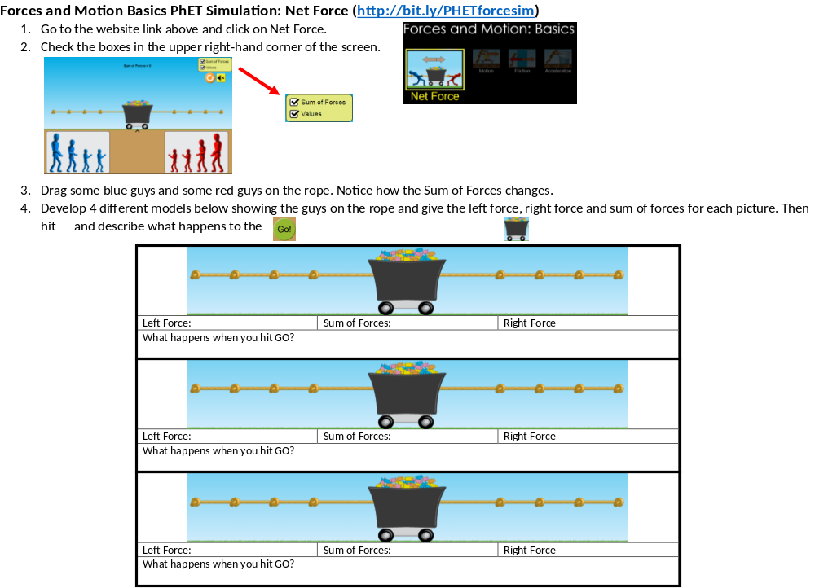
Join TEAMS and complete the PhET assignment.
When you open this document in TEAMS, click the edit button and then open in desktop app.
Standards: 8.PS2.3, 8PS2.4, 8.PS2.5

Slide 4
Exit Ticket:
What happens to an unbalanced force?

